Slide 1

Videogames sales predictions

Slide 2
Data Exploration
16,719 observations
16 variables
17% missing values
Notes:
Me quede con 6825 observaciones despues de eliminar datos nulos

Slide 3
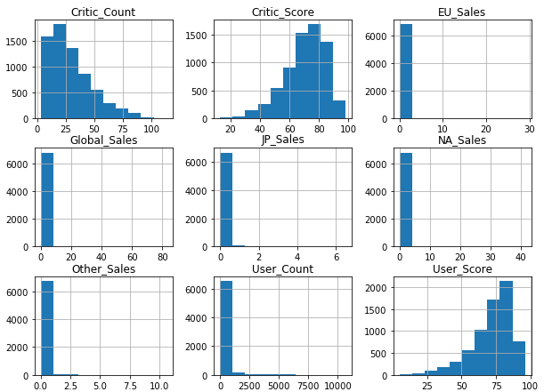
Data Exploration
Notes:
Many games doesn’t sell above a million copies

Slide 4
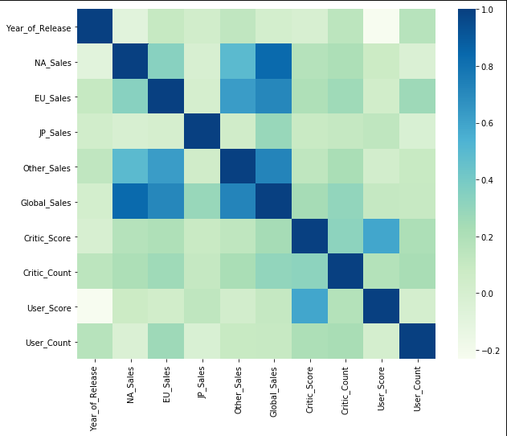
Data Exploration

Slide 5
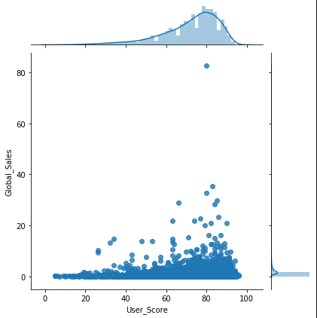
Data Exploration

Slide 6
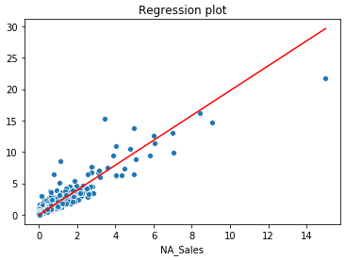
Linear Regression
R squared = 0.92
RMSE = 0.60

Slide 7
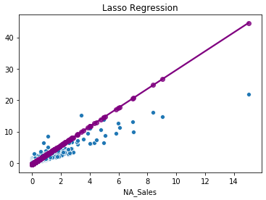
Lasso Regression
R squared = 0.87
RMSE = 0.57
Alpha = 0.20

Slide 8
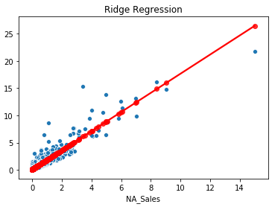
Ridge Regression
R squared = 0.87
RMSE = 0.57
Alpha = 668

Slide 9
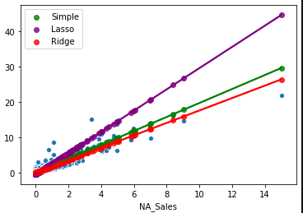
Regression Comparison

Slide 10
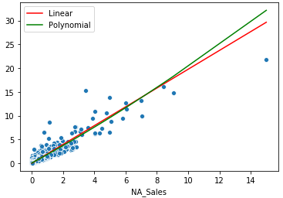
Polynomial Regression
R squared = 0.92
RMSE = 0.63

Slide 11
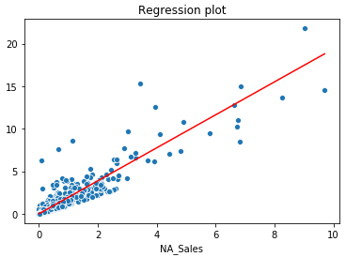
Linear regression with no outlier
R squared = 0.89
RMSE = 0.64

Slide 12
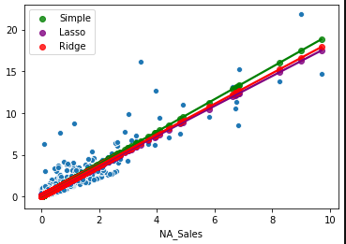
Regression comparison with sales under 50 million
Linear score = 0.89, 0.64
Lasso score = 0.84, 0.64 | alpha = 0.1
Ridge score = 0.84, 0.64 | alpha = 205

Slide 13
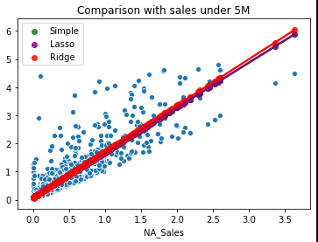
Regression comparison with sales under 5 million
Linear score = 0.82, 0.39
Lasso score = 0.77, 0.39 | alpha = -1.77
Ridge score = 0.77, 0.38 | alpha = -29

Slide 14
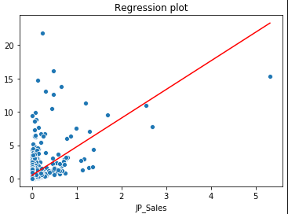
Japan Sales instead of North America Sales
R squared = 0.40
RMSE = 1.45

Slide 15
Conclusion
Removing outliers can sometimes make a better model
Polynomial regression was a slight worse.
Lasso or Ridge gives the best fit
North America sales is a good measure of how the Global Sales will be
Lasso and Ridge regression has the same scores on it’s best case scenario

Slide 16


